Slide 1
Aws resources
ow

Slide 2
Resource
In Terraform, a "resource type" refers to the type of infrastructure resource that you are managing.
Terraform uses resource types to define the various components of your infrastructure, such as virtual machines, networks, databases, and more.
Each resource type corresponds to a specific provider, and providers are responsible for interacting with APIs of different cloud or infrastructure platforms.

Slide 3
Resource Type
aws_instance: Represents an EC2 instance.
aws_security_group: Manages security groups.
aws_subnet: Manages subnets.
aws_s3_bucket: Manages an S3 bucket.
aws_rds_instance: Represents an RDS database instance.
aws_key_pair: Manages key pairs for SSH access.

Slide 4
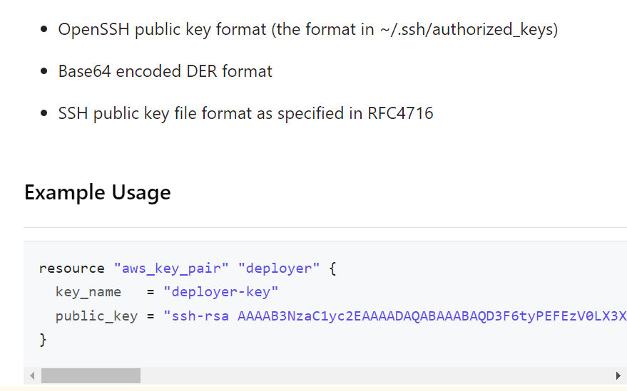
Aws_key_pair

Slide 5
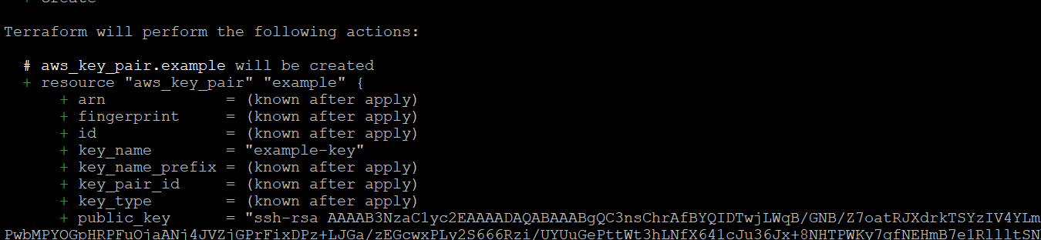
Run: terraform plan

Slide 6
Vpc and subnet
resource "aws_vpc" "example" {
cidr_block = "10.0.0.0/16"
}
resource "aws_subnet" "example_subnet" {
vpc_id = aws_vpc.example.id
cidr_block = "10.0.1.0/24"
availability_zone = "us-west-1a"
map_public_ip_on_launch = true # Set this to true if you want instances in this subnet to receive public IP addresses
tags = {
Name = "example-subnet"
}
}

Slide 7
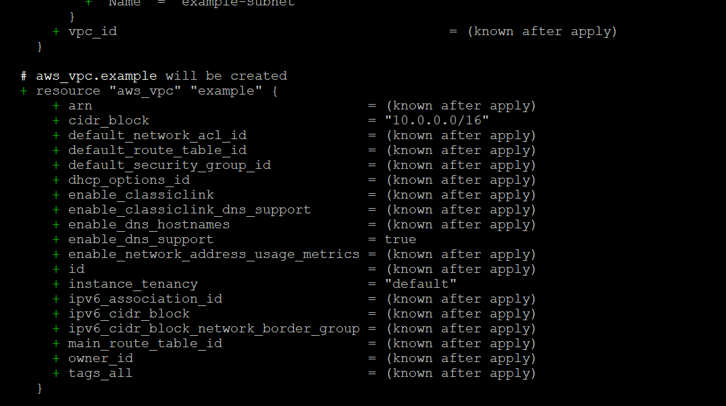
..

Slide 8
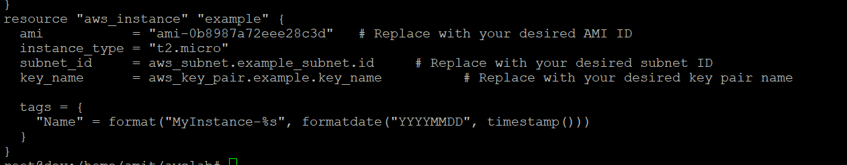
Ec2 instance creation

Slide 9
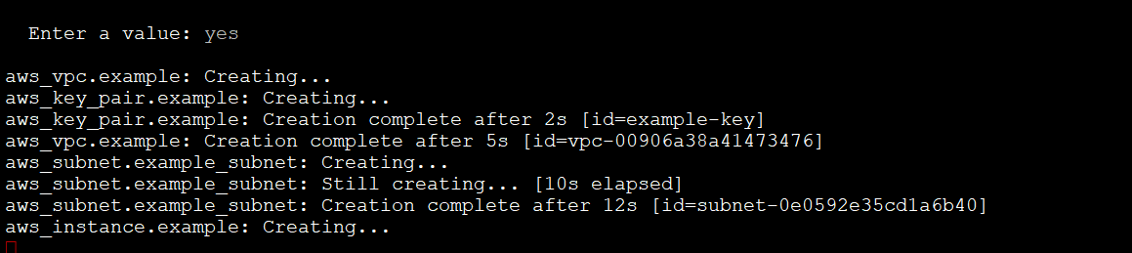
..terraform apply

